Slide 1
MULTINOMIAL LOGISTIC REGRESSION

Slide 2
Contents
Basics of Multinomial Logistic Regression
Application areas
Statistical Model
Case Study
Model fitting in R
Predicted Probabilities and Classification Table

Slide 3
Multinomial Logistic Regression
DEPENDENT VARIABLE
INDEPENDENT VARIABLE
Nominal
(With more than two mutually exclusive and exhaustive categories)
Categorical or Continuous
If there are k categories for the dependent variable then (k-1) logit functions are defined with remaining 1 category as base level.

Slide 4
Application Areas
Industry / Function
Model
Based on Information such as:
Marketing
Buyers’ Brand Preference
Age, Gender, Payment Mode, Purchase Frequency, Historical purchase details, etc.
Education
Electives Chosen by Students
Student Gender, Subjects Chosen at the Current Level, Current Academic Score, etc.
Healthcare
Common painkiller used
Demographics, Type of Ailment, socio-economic background, etc.

Slide 5
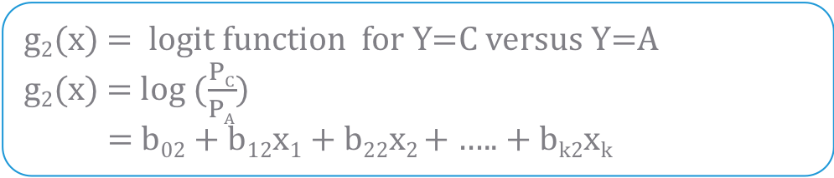
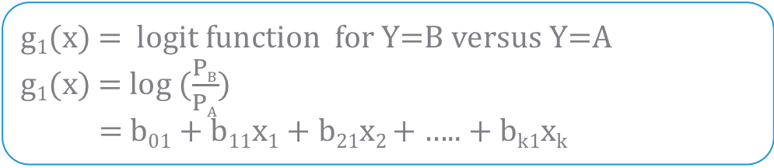
Statistical Model
Let Y be the dependent variable with 3 categories as A,B,C and X1 ,X2,…Xk are k Independent variables.
There will be 2 logit functions: one for Y=B versus Y=A and other Y=C versus Y=A
Assuming A as the base category.
Parameters of the model are estimated by Maximum Likelihood Estimation(MLE) Method.
g₁(x) = logit function for Y=B versus Y=A
g₁(x) = log ($\frac{PB}{PA}$)
= b₀₁ + b₁₁x₁ + b₂₁x₂ + ….. + b_{k1}x_{k}
where,
P_{B} = P [ Y= B | x ]
P_{A} = P [ Y= A | x ]
g₂(x) = logit function for Y=C versus Y=A
g₂(x) = log ($\frac{PC}{PA}$)
= b₀₂ + b₁₂x₁ + b₂₂x₂ + ….. + b_{k2}x_{k}
where.
P_{C} = P [ Y= C | x ]

Slide 6
Case Study – High School Program Choice
Background
Objective
Available Information
At the time of entering high school, students make program choices among general program, vocational program and academic program. Their choice can be modeled using their writing score and their socio-economic status.
To model student’s choice of programs.
Independent Variables: Socio-Economic Status (SES) and Writing Score.
Sample size is 200
Dependent Variable: Program Chosen (General, Vocational or Academic)
Data source: https://stats.idre.ucla.edu/

Slide 7
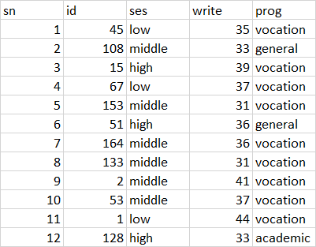
Data Snapshot
High School Data
Independent Variables
Dependent Variable
Column | Description | Type | Measurement | Possible Values
sn | serial number | numeric | - | -
id | student id | numeric | - | -
ses | scoio-economic status | Categorical | low, middle, high | 3
write | writing score of the students | continuous | - | positive value
prog | program chosen by students | categorical | vocational, general, academic | 3
Observations

Slide 8
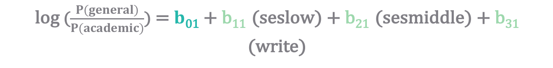
Model for the case study
There are two categorical variables in the data: ‘prog’ and ‘ses’.
- For the Dependent variable ‘prog’, ‘academic’ is taken as base category.
- For the Independent variable ‘ses’, high’ is taken as base category.
Model for the general vs academic is given as:
Logit Function 1
Intercept
Independent Variables
log ($\frac{P(general)}{P(academic)}$) = $b$₀₁ + b₁₁ (seslow) + b₂₁ (sesmiddle) + b₃₁ (write)
Parameter Estimates

Slide 9
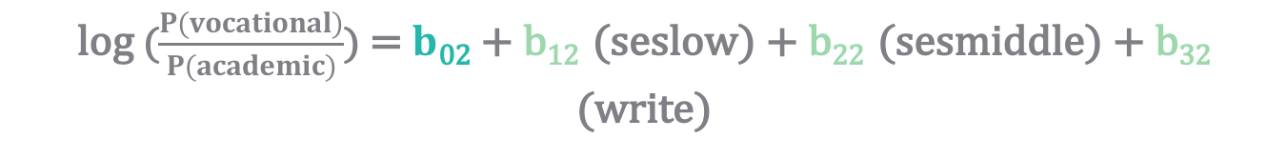
Model for the case study
Model for the vocational vs academic is given as:
Logit Function 2
Intercept
Independent Variables
log ($\frac{P(vocational)}{P(academic)}$) = $b$₀₂ + b₁₂ (seslow) + b₂₂ (sesmiddle) + b₃₂ (write)
Parameter Estimates

Slide 10

Maximum Likelihood Estimates of Parameters
Coefficients
 | Intercept | seslow | sesmiddle | write
general | 1.689478 | 1.1628411 | 0.6295638 | -0.05793086
vocation | 4.235574 | 0.9827182 | 1.2740985 | -0.11360389
Standard Errors
 | Intercept | seslow | sesmiddle | write
general | 1.226939 | 0.5142211 | 0.4650289 | 0.02141101
vocation | 1.204690 | 0.5955688 | 0.5111119 | 0.02222000
log ($\frac{P(general)}{P(academic)}$) = 1.689478 + 1.1628411(seslow) + 0.629568 (sesmiddle) + (-0.05793086) (write)
Similar to this, there will be another model equation for the category ‘vocation’ with ‘academic’ as base category.

Slide 11
Model Fitting in R
#Import the data
data<-read.csv("High School Data.csv", header=TRUE) str(data) data$prog<-as.factor(data$prog)
data$prog<-relevel(data$prog, ref="academic") # Install and load package ‘nnet’. install.packages("nnet") library(nnet)
relevel() tells R to re-order levels of a factor so that the level specified by ref is first and the others are moved down. First level is then taken as reference (base) category.

Slide 12
Model Fitting in R
#Run Multinomial Logistic Model
choicemodel<-multinom(prog~ses+write,data=data) m<-summary(choicemodel) m
mulinom() fits a Multinomial Logistic Regression. Dependent variable is followed by ‘~’ and independent variables are separated by plus signs.
The output of multinom() function does not contain all the parameters required for further testing.
In order to be able to extract specific components from the output and perform more actions on them, an object is created from summary().

Slide 13
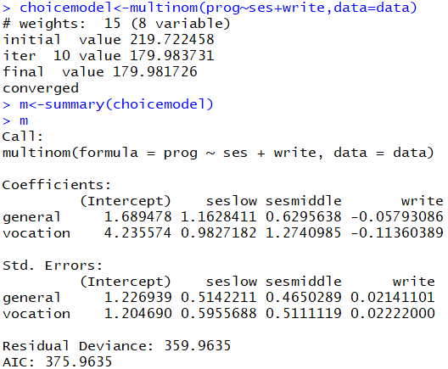
Model Fitting in R
# Output
Output gives coefficients and standard errors of variables for each logit.

Slide 14
Individual Testing Using Wald’s Test
Individual testing is used for checking significance of each independent variable separately.
Objective | To test the null hypothesis that each variable is insignificant
Null Hypothesis (H₀): b_{i1} = 0 (for 1st logit)
Alternate Hypothesis (H₁): b_{i1} ≠ 0 ((for 1st logit)
i=1,2…,k
Null Hypothesis (H₀): b_{i2} = 0 (for 2nd logit)
Alternate Hypothesis (H₁): b_{i2} ≠ 0 (for 2nd logit)
i=1,2…,k
Test Statistic | Z² = (b_{i1} / Std. Error of b_{i1})² Under H0, Z² ~ χ ²₍₁₎
Decision Criteria | Reject the null hypothesis if p-value < 0.05

Slide 15
Individual Testing- Case study
Table of p-values
 | Intercept | seslow | sesmiddle | write
general | 0.1685163893 | 0.02373673 | 0.1757949 | 6.816914e-03
vocational | 0.0004382601 | 0.09893276 | 0.0126741 | 3.176088e-07
p-value for seslow (general), sesmiddle (vocational) and write (general and vocational) < 0.05

Slide 16
Interpretation of Results
Coefficients
 | Intercept | seslow | sesmiddle | write
general | 1.689478 | 1.1628411 | 0.6295638 | -0.05793086
vocational | 4.235574 | 0.9827182 | 1.2740985 | -0.11360389
P-values
general | 0.1685163893 | 0.02373673 | 0.1757949 | 6.816914e-03
vocational | 0.0004382601 | 0.09893276 | 0.0126741 | 3.176088e-07
‘write’ is a significant variable. Higher the writing score, less preference to ‘general’ or ‘vocational’(as academic is base category and coefficient sign is negative).
‘Low’ SES category prefer ‘general’ over ‘academic’ more than ‘high’ SES category (as high SES is base category).
‘middle’ SES category prefer ‘vocation’ over ‘academic’ more than ‘high’
SES category.

Slide 17
Individual Testing in R
#Individual Testing
z<-m$coefficients/m$standard.errors pvalue <-1-pchisq(z^2,df=1) pvalue
‘z’ creates a dataframe of Z values as coefficients divided by standard errors
pchisq() is used to calculate p-values using square of Z and degrees of freedom as arguments
pvalue stores table of p-values.

Slide 18

Individual Testing in R
# Output:
Interpretation :
seslow(general), write(general), sesmiddle (vocation), write( vocation) are significant, as p-value <0.05.

Slide 19
Classification Table
Cross tabulation of observed values of Y and estimated values of Y is called as Classification Table.
The predictive success of the logistic regression can be assessed by looking at the classification table
Classification
Observed | Predicted
 | academic | general | vocation | Percent Correct
academic | 92 | 4 | 9 | 87.61%
general | 27 | 7 | 11 | 15.56%
vocation | 23 | 4 | 23 | 46.00%
Overall Percentage | 71.0% | 7.5% | 21.5% | 61.0%
Table shows that, model is predicting 61%=(92+7+23)/ 200 correctly.

Slide 20
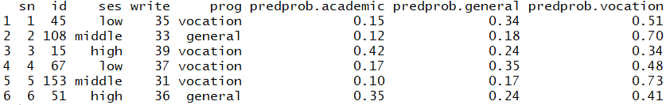
Predicted Probabilities and Classification Table in R
# Predicted Probabilities
data$predprob<-round(fitted(choicemodel),2) head(data)
fitted() generates predicted probabilities for program choice.
# Output:
Predicted category is Vocation since it has highest probability 0.51
Interpretation :
Predicted probabilities are given for each outcome (academic, general, vocation).
Category of the maximum of these probabilities is taken as predicted category of that observation.

Slide 21
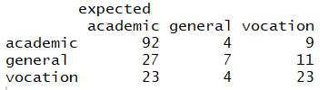
Predicted Probabilities and Classification Table in R
# Classification Table
expected<-predict(choicemodel,data, type="class") ctable<-table(data$prog,expected) ctable
predict() returns predicted values.
type=“class” returns a factor of classifications based on the responses (frequency). type=“probs” returns matrix of probabilities.
table() function simply gives the true positive and negative rates of the model (in the form of counts), which are key to deciding power of the model.
# Output:
Interpretation :
Classification table of predicted and expected counts.

Slide 22
Quick Recap
In this session, we learned about Multinomial Logistic Regression :
Multinomial Logistic Regression
Dependent variable is nominal with more than two categories and independent variables are categorical or continuous or mix of both.
Parameters are estimated using MLE.
If there are k categories for the dependent variable then (k-1) logit functions are defined with remaining 1 category as base level.
Multinomial Logistic regression in R
relevel() used to define base category.
nnet() library required for multinomial regression
multinom() performs multinomial logistic regression
Use summary() function to extract more details from multinom() function.

Slide 23
THANK YOU!!

